Slide 1
离散数据及其应用 Discrete Mathematics and Its Applications （Eighth Edition/Kenneth H.Rosen） 郭少勇 (syguo@bupt.edu.cn) 北京邮电大学 2025.11
Notes:
1

Slide 2
Graphs
10.1 图和图模型/Graphs and Graph Models
10.2 图的术语和几种特殊的图/Graph Terminology and Special Types of Graphs
10.3 图的表示与同构/Representing Graphs and Graph Isomorphism
10.4 连通性/Connectivity
10.5 欧拉道路与哈密尔顿道路/Euler and Hamilton Paths
10.6 最短道路问题/Shortest-Path Problems
10.7 平面图/Planar Graphs
10.8 图的着色/Graph Coloring

Slide 3
10.4 Paths
Definition 1
Let n be a nonnegative integer and G an undirected graph. A path of length n from u to v in G is a sequence of n edges e₁, … , e_{n} of G for which there exists a sequence x₀ = u, x₁, … , x_{n-1}, x_{n} = v of vertices such that e_{i} has, for i = 1, … , n, the endpoints x_{i-1} and x_{i}. When the graph is simple, we denote this path by its vertex sequence x₀, x₁, … , x_{n} (because listing these vertices uniquely determines the path). The path is a circuit if it begins and ends at the same vertex, that is, if u = v, and has length greater than zero. The path or circuit is said to pass through the vertices x₁, x₂, … , x_{n-1} or traverse the edges e₁, e₂, … , e_{n}. A path or circuit is simple if it does not contain the same edge more than once.

Slide 4
10.4 Paths
When it is not necessary to distinguish between multiple edges, we will denote a path e₁, e₂, … , e_{n}, where e_{i} is associated with {x_{i−1}, x_{i}} for i = 1, 2, … , n by its vertex sequence x₀, x₁, … , x_{n}. This notation identifies a path only as far as which vertices it passes through. Consequently, it does not specify a unique path when there is more than one path that passes through this sequence of vertices, which will happen if and only if there are multiple edges between some successive vertices in the list. Note that a path of length zero consists of a single vertex.

Slide 5
10.4 Paths
Remark
There is considerable variation of terminology concerning the concepts defined in Definition 1. For instance, in some books, the term walk(路径) is used instead of path, where a walk is defined to be an alternating sequence of vertices and edges of a graph, v₀, e₁, v₁, e₂, … , v_{n−1}, e_{n}, v_{n}, where v_{i−1} and v_{i} are the endpoints of e_{i} for i = 1, 2, … , n. When this terminology is used, closed walk (路径) is used instead of circuit(回路) to indicate a walk that begins and ends at the same vertex, and trail(路线) is used to denote a walk that has no repeated edge (replacing the term simple path). When this terminology is used, the terminology path(通路) is often used for a trail with no repeated vertices, conflicting with the terminology in Definition 1.

Slide 6
10.4 Paths
Definition 2
Let n be a nonnegative integer and G a directed graph. A path of length n from u to v in G is a sequence of edges e₁, e₂,… , e_{n} of G such that e₁ is associated with (x₀, x₁), e₂ is associated with (x₁, x₂), and so on, with en associated with (x_{n-1}, x_{n}), where x₀ = u and x_{n} = v. When there are no multiple edges in the directed graph, this path is denoted by its vertex sequence x₀, x₁, x₂, … , x_{n}. A path of length greater than zero that begins and ends at the same vertex is called a circuit or cycle. A path or circuit is called simple if it does not contain the same edge more than once.

Slide 7
10.4 Connectivity
Connectivity /连通性
[定义]道路/path:
当Ｇ中相邻边的序列（Ｖ₀，Ｖ₁），（Ｖ₁，Ｖ₂），…
（Ｖ_{k-1}，Ｖ_{k}）称为一条道路（通路）。此道路的长度为ｋ。也可以（Ｖ₀，Ｖ₁，…，Ｖ_{k}）表示道路，Ｖ₀为起点，Ｖ_{k}为终点。
当Ｖ₀=Ｖ_{k}时，该道路称为回路/circuit。

Slide 8
10.4 Connectivity
Connectivity /连通性
[定义]简单道路/Simple Path：
一条道路中没有两条边是相同的，称此道路为简单道路。当其是回路时，称为简单回路/Simple Circuit。
[定义]基本道路/Element Path：
一条道路中，除了起点和终点可以相同，没有其他相同顶点出现，称此道路为基本道路。当其是回路时，称为基本回路/Element Circuit。

Slide 9
10.4 Connectivity
（ｅ₅，ｅ₁ ，ｅ₂ ，ｅ₃，ｅ₄）是简单道路，不是基本道路，因为（ｃ，ａ，ｂ，ｃ，ｄ，ｂ）中ｂ，ｃ均出现了两次。但（c，d，b，c）是基本道路。

Slide 10
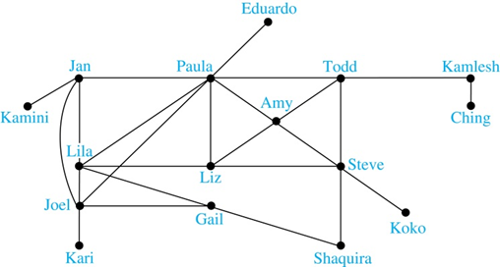
10.4 Connectivity
Degrees of Separation
Example: Paths in Acquaintanceship Graphs(相识关系图中的通路). In an acquaintanceship graph there is a path between two people if there is a chain of people linking these people, where two people adjacent in the chain know one another. In this graph there is a chain of six people linking Kamini and Ching.
Some have speculated that almost every pair of people in the world are linked by a small chain of no more than six, or maybe even, five people. The play Six Degrees of Separation by John Guare is based on this notion.

Slide 11
10.4 Connectedness in Undirected Graphs
Definition 3
An undirected graph is called connected if there is a path between every pair of distinct vertices of the graph. An undirected graph that is not connected is called disconnected. We say that we disconnect a graph when we remove vertices or edges, or both, to produce a disconnected subgraph.

Slide 12
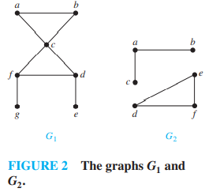
10.4 Paths
Example :
The graph G₁ in Figure 2 is connected, because for every pair of distinct vertices there is a path between them. However, the graph G₂ in Figure 2 is not connected. For instance, there is no path in G₂ between vertices a and d.

Slide 13
10.4 Connectedness in Directed Graphs
Definition 4
A directed graph is strongly connected if there is a path from a to b and from b to a whenever a and b are vertices in the graph.
For a directed graph to be strongly connected there must be a sequence of directed edges from any vertex in the graph to any other vertex. A directed graph can fail to be strongly connected （强连通）but still be in “one piece.”

Slide 14
10.4 Connectedness in Directed Graphs
Definition 5
A directed graph is weakly connected（弱连通） if there is a path between every two vertices in the underlying undirected graph.
That is, a directed graph is weakly connected if and only if there is always a path between two vertices when the directions of the edges are disregarded. Clearly, any strongly connected directed graph is also weakly connected.

Slide 15
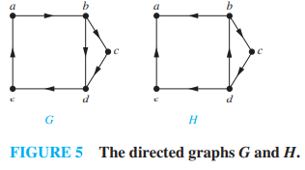
10.4 Connectedness in Directed Graphs
Example :
Are the directed graphs G and H shown in Figure 5 strongly connected? Are they weakly connected?

Slide 16
10.4 Connectedness in Directed Graphs
Solution:
G is strongly connected because there is a path between any two vertices in this directed graph (the reader should verify this). Hence, G is also weakly connected. The graph H is not strongly connected. There is no directed path from a to b in this graph. However, H is weakly connected, because there is a path between any two vertices in the underlying undirected graph of H (the reader should verify this).

Slide 17
10.4 Connectivity
[定义]连通性/connectivity：
设Ｇ＝（Ｖ，Ｅ）， （Ｖ₀，Ｖ₁，…，Ｖ_{k}） 是G中的一条道路，则称Ｖ₀到Ｖ_{k}连通/connective或可达/。
说明：对无向图而言，若Ｖ₀到Ｖ_{k}可达，则Ｖ_{k}到Ｖ₀也可达。对有向图而言则未必。

Slide 18
10.4 Connectivity
[定义]无向图的连通性：
若Ｇ＝（Ｖ，Ｅ）中任两个不同顶点都连通，则称此无向图是连通的/connected。
[定理1]
任意一个连通无向图的任两个不同顶点都存在一条简单道路。

Slide 19
10.4 Connectivity
[定义]无向图的连通性：
若Ｇ＝（Ｖ，Ｅ）中任两个不同顶点都连通，则称此无向图是连通的/connected。
[定义]连通分图/connected components：
图Ｇ可分为几个不相连通的子图，每一子图本身都是连通的。称这几个子图为Ｇ的连通分图。

Slide 20
10.4 Connectivity
Directed Connectedness
A directed graph is strongly connected iff there is a directed path from a to b for any two verts a and b.
It is weakly connected iff the underlying undirected graph (i.e., with edge directions removed) is connected.
Note strongly implies weakly but not vice-versa.

Slide 21
10.4 Connectivity
[定义]有向图的连通性：
(1)弱连通：
若Ｇ＝（Ｖ，Ｅ）对应的无向图是连通图，则称Ｇ为弱连通/weakly connected。
(2）强连通：
若Ｇ＝（Ｖ，Ｅ）中任两点间都有路，即对ａ与ｂ，ａ到ｂ可达，ｂ到ａ可达，称Ｇ为强连通/strongly connected。

Slide 22
10.4 Connectivity

Slide 23
10.4 Connectivity

Slide 24
10.4 Connectivity
例：用图描述一台自动售货机，只用５分，１０分二种硬币，满１５分后压按钮，选择一块巧克力，钱多了不找还。

Slide 25
10.4 Connectivity
顶点：ａ：０ 分边： ５：投５分
ｂ：５分 １０：投１０分
ｃ：１０分 ｐ：压按扭动作
ｄ：≥１５分
表示已投入钱的状态 表示一种动作
自动售货机：有向加权图描绘得很清楚
（1）钱数不够，压按扭，不起作用
（2）钱数够了，压按扭，给过糖果回到０分状态
（3）钱超过１５分，再加钱白加

Slide 26
10.4 Connectivity
Counting Paths w Adjacency Matrices
Let A be the adjacency matrix of graph G.
The number of paths of length k from v_{i} to v_{j} is equal to (A^{k})_{i,j}.
The notation (M)_{i,j} denotes m_{i,j} where [m_{i,j}] = M.

Slide 27
10.4 Connectivity
用邻接矩阵讨论图Ｇ的连通性质：
在邻接矩阵中，若ａ_{ij}＝１，表明Ｖ_{i}到Ｖ_{j}有一条边，即Ｖ_{i}到Ｖ_{j}可达；若ａ_{ij}＝０不说明Ｖ_{i}到Ｖ_{j}没有道路，若通过其他点中转，也有可能连通。作邻接矩阵的普通矩阵乘法：

Slide 28
10.4 Connectivity
ｂ_{ij}的值表示Ｖ_{i}到Ｖ_{j}路长为２的道路条数，一般地，就有：
[定理2]
Ａ^{m}的元素ｍ_{ij}表示Ｖ_{i}到Ｖ_{j}长度为ｍ的道路条数。

Slide 29
10.4 Connectivity
[定理3]：
ｎ个顶点的图Ｇ中，如果Ｖ_{i}到Ｖ_{j}（Ｖ_{i}≠Ｖ_{j}）有道路，则其最短的道路长度≤ｎ－１。
[定理4]：
ｎ个顶点的图Ｇ中，A是G的邻接矩阵。Ｖ_{i}、Ｖ_{j} 是G的顶点，
B=A+A²+…+A^{n-1}
则Ｖ_{i}到Ｖ_{j}（Ｖ_{i}≠Ｖ_{j}）连通当且仅当b _{ij} 非零。

Slide 30
10.4 Connectivity
定义：ｎ个顶点的图Ｇ中，A是G的邻接矩阵。
B=A+A²+…+A^{n-1} +A^{n}
称为G的可达性矩阵。
有向图的连通性（n>1）：
（１）B中元素全为１⇔Ｇ强连通
（2）Ａ∨Ａ^{T}的可达性矩阵元素全为１⇔Ｇ是弱连通的。
无向图的连通性（n>1）：
B中元素全为１⇔Ｇ连通

Slide 31
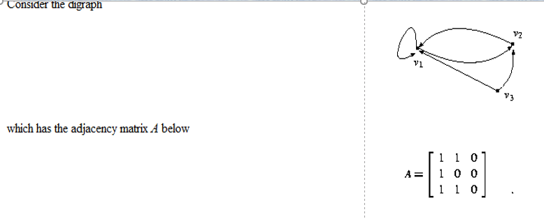
10.4 Connectivity

Slide 32
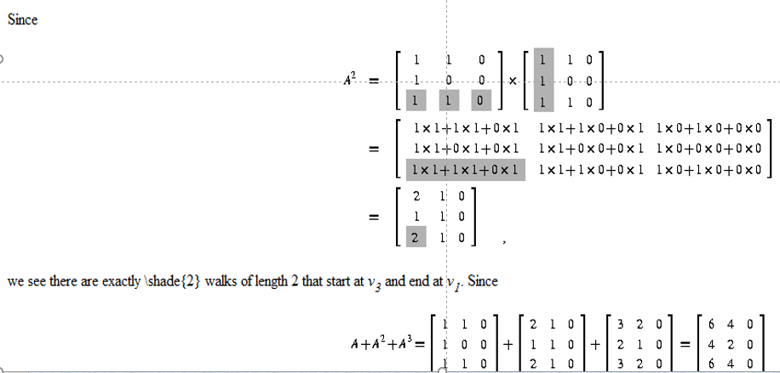
10.4 Connectivity

Slide 33
10.5.1 Introduction
10.5 Euler and Hamilton Path (Konigsberg(哥尼斯堡)七桥问题)
问题：能否从河岸或小岛出发，通过每一座桥，而且仅仅通过一次回到原地。

Slide 34
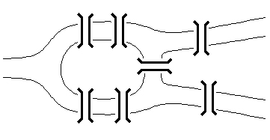
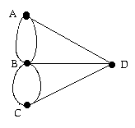
10.5.1 Introduction
Bridges of Königsberg Problem
Can we walk through town, crossing each bridge exactly once, and return to start?
Equivalent multigraph
The original problem

Slide 35
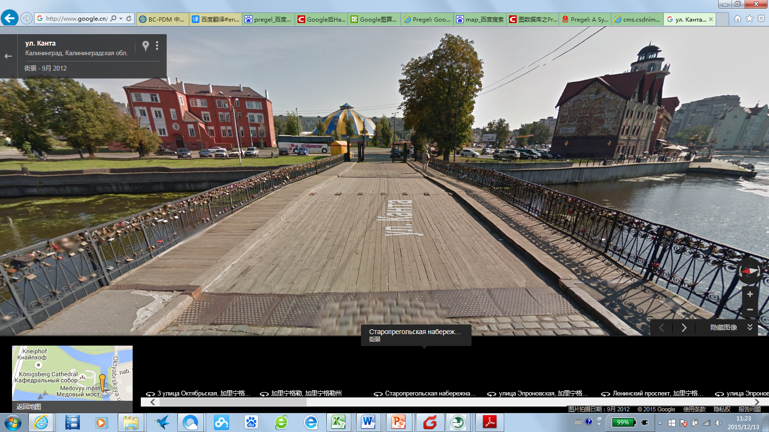
10.5.1 Introduction

Slide 36
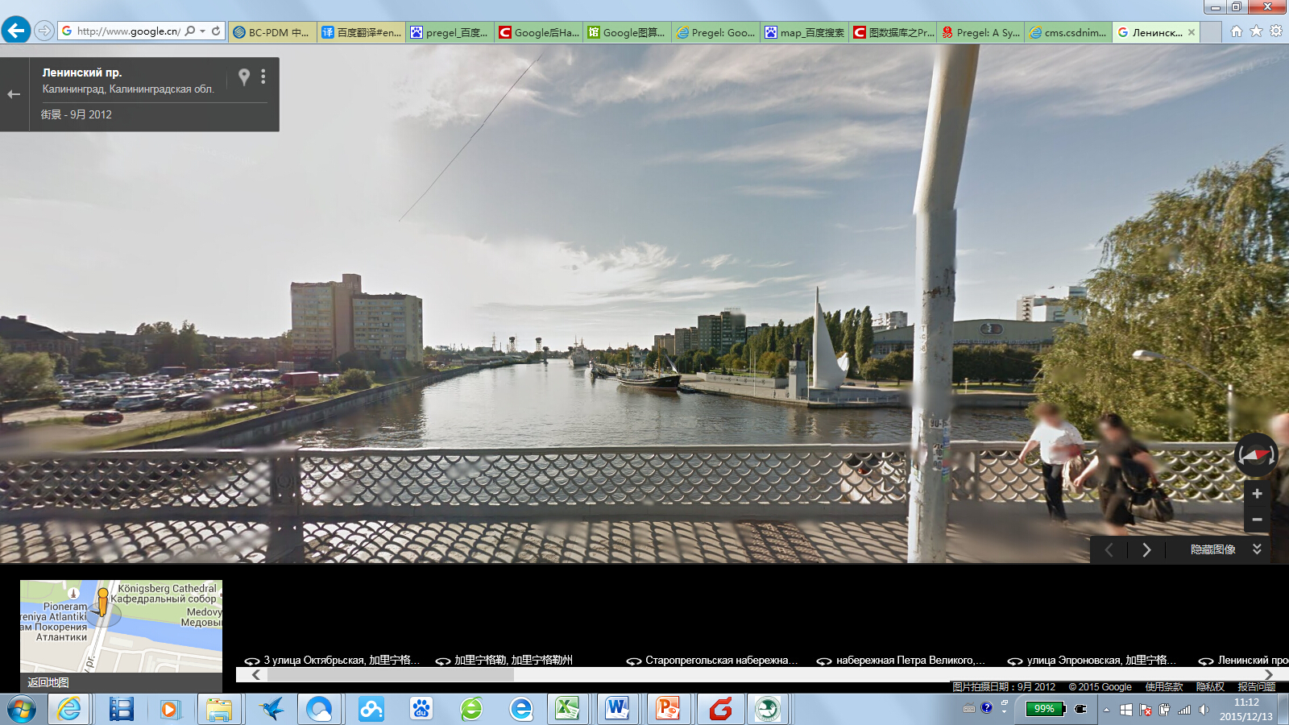
10.5.1 Introduction

Slide 37
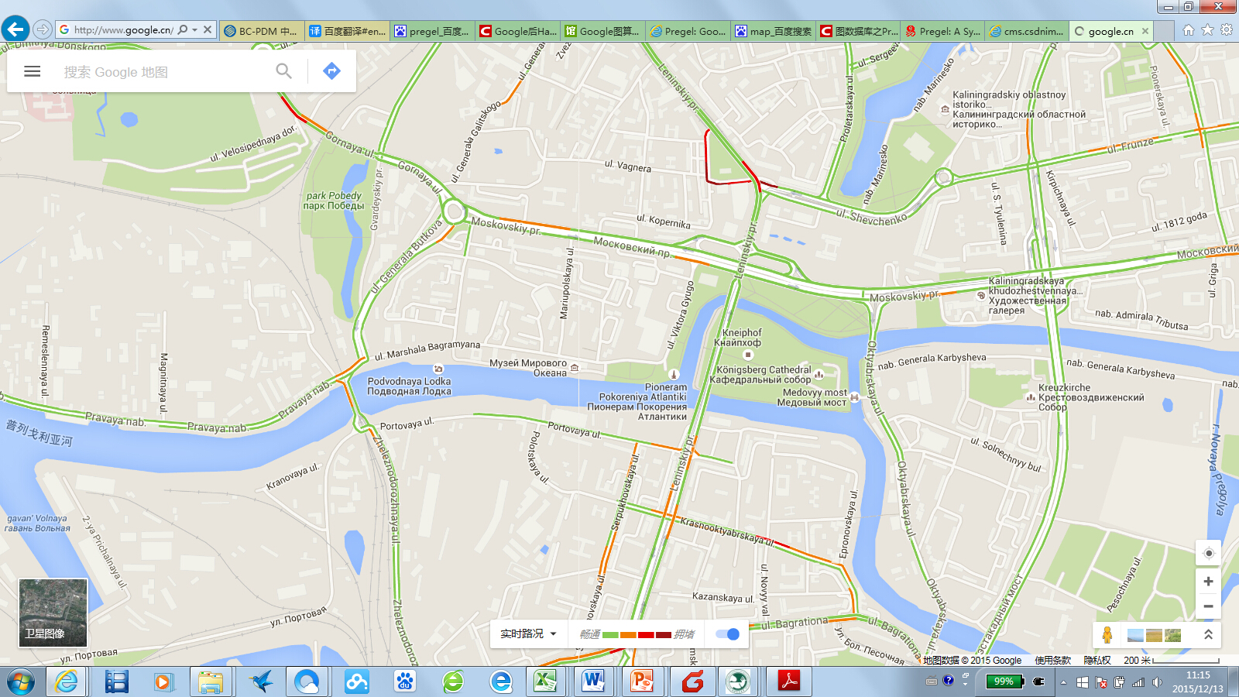
10.5.1 Introduction

Slide 38
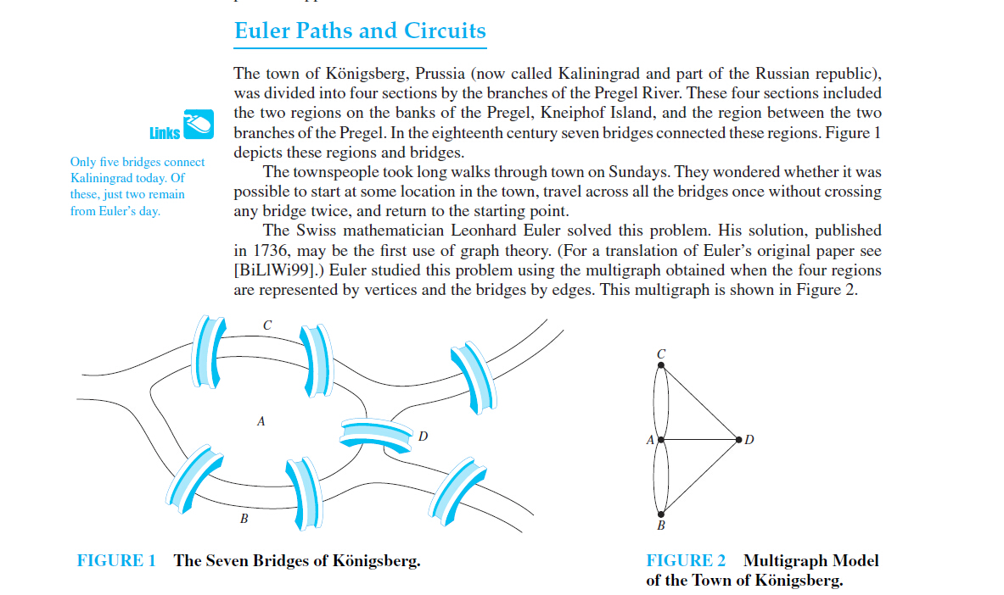
10.5.1 Introduction

Slide 39
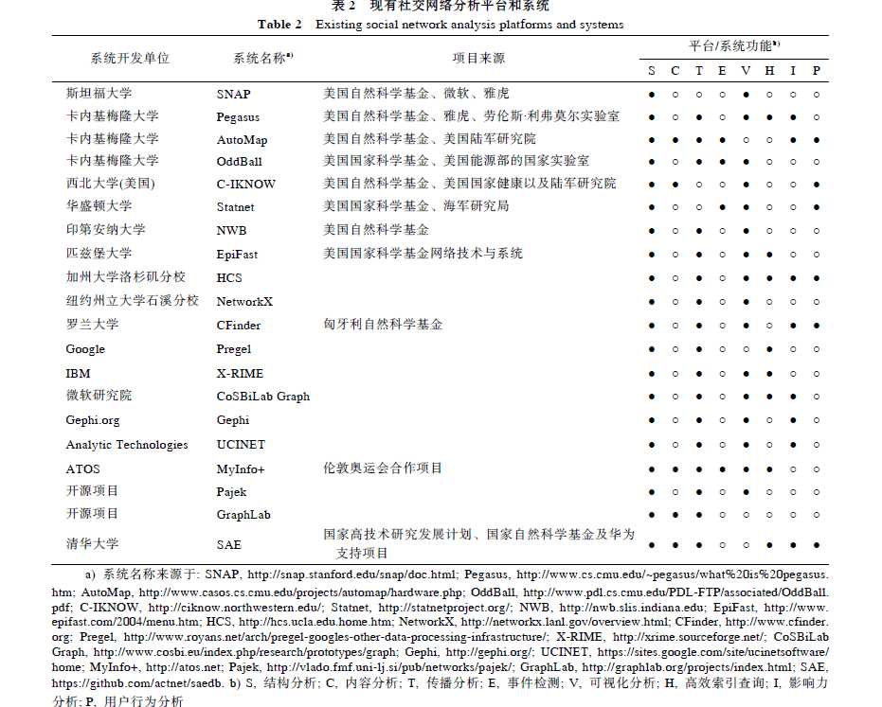

Slide 40
10.5.2 Euler Paths and Circuit
Euler(欧拉)1736年对这个问题，给出了否定的回答。将河岸和小岛作为图的顶点，七座桥为边，构成一个无向多重图，问题化为图论中简单回路的问题：在这个多重图中是否存在着包含每一条边的简单回路？

Slide 41
10.5.2 Euler Paths and Circuit
Definition 1
An Euler circuit(欧拉回路) in a graph G is a simple circuit containing every edge of G. An Euler path(欧拉通路) in G is a simple path containing every edge of G

Slide 42
10.5.2 Euler Paths and Circuit
Eulerian graph（欧拉图）
A walk in a graph is called an Euler tour(欧拉序) if it starts and ends in the same place and uses each edge exactly once.
A walk in a graph is called an Euler trail(欧拉迹) if it uses each edge exactly once.
If a graph has an Euler tour, it is said to be an Eulerian graph.

Slide 43
10.5.2 Euler Paths and Circuit
欧拉通路（回路）
在无向连通简单图中，通过图中每边一次且仅一次并行遍每个结点的一条通路（回路）。
欧拉图：存在欧拉回路的图

Slide 44
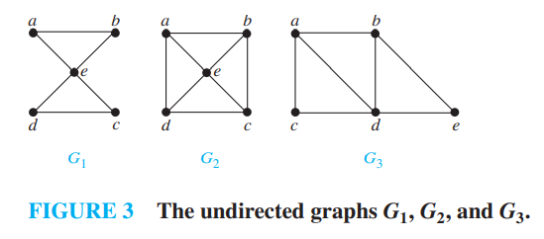
10.5.2 Euler Paths and Circuit
Example 1:
Which of the undirected graphs in Figure 3 have an Euler circuit? Of those that do not, which have an Euler path？

Slide 45
10.5.2 Euler Paths and Circuit
Solution:
The graph G₁ has an Euler circuit, for example, a, e, c, d, e, b, a. Neither of the graphs G₂ or G₃ has an Euler circuit (the reader should verify this). However, G₃ has an Euler path, namely, a, c, d, e, b, d, a, b. G₂ does not have an Euler path (as the reader should verify)

Slide 46
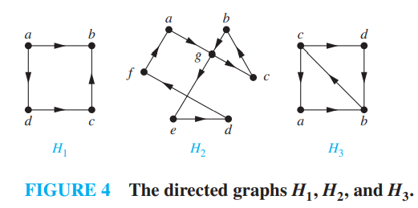
10.5.2 Euler Paths and Circuit
Example 2:
Which of the directed graphs in Figure 4 have an Euler circuit? Of those that do not, which have an Euler path?

Slide 47
10.5.2 Euler Paths and Circuit
Solution:
The graph H₂ has an Euler circuit, for example, a, g, c, b, g, e, d, f, a. Neither H₁ nor H₃ has an Euler circuit (as the reader should verify). H₃ has an Euler path, namely, c, a, b, c, d, b,but H₁ does not (as the reader should verify).

Slide 48
10.5.2 Euler Paths and Circuit
Euler Path Theorems
Theorem: A connected multigraph(连通多重图) has an Euler circuit iff each vertex has even degree.
Proof:
(→) The circuit contributes 2 to degree of each node.
(←) By construction using algorithm on p. 696
Theorem: A connected multigraph has an Euler path (but not an Euler circuit) iff it has exactly 2 vertices of odd degree.
One is the start, the other is the end.

Slide 49
10.5.2 Euler Paths and Circuit
Theorem 1
(a)If a graph G has a vertex of odd degree, there can be no Euler Circuit in G.
(b)If G is a connected graph and every vertex has even degree, then there is an Euler circuits in G.

Slide 50
10.5.2 Euler Paths and Circuit
Theorem 2
(a) If a graph G has more than two vertices of odd degree, then there can be no Euler path in G.
(b) If G is connected and has exactly two vertices of odd degree, there is an Euler path in G. Any Euler path in G must begin at one vertex of odd degree and end at the other.

Slide 51
10.5.2 Euler Paths and Circuit
(a) More than two vertices of odd degree
Let v₁, v₂ , v₃ be vertices of odd degree. And possible Euler path must leave(or arrive at) each of v₁, v₂ , v₃ with no way to return(or leave) since each of these vertices has odd degree. One vertex of these three vertices may be the beginning of the Euler path and another the end, but this leaves the third vertex at one end of an untraveled edge.
Thus there is no Euler path.

Slide 52
10.5.2 Euler Paths and Circuit
(b) If G is connected and has exactly two vertices of odd degree, there is an Euler path in G. Any Euler path in G must begin at one vertex of odd degree and end at the other.
Let u and v be the two vertices of odd degree.
Add the edge (u,v)
There is an Euler circuit π
Omitting (u,v) from π
Produces a Euler path.

Slide 53
10.5.2 Euler Paths and Circuit
定理:
无向连通图G是欧拉图的充分必要条件是G不含奇数度结点。
推论：
非平凡连通图G有欧拉通路的充分必要条件是G最多有两个奇数度结点。

Slide 54
10.5.2 Euler Paths and Circuit
定理:
连通有向图D含有有向欧拉回路的充分必要条件是D中每个结点的入度等于出度。

Slide 55
10.5.2 Euler Paths and Circuit
说明:
哥尼斯堡七桥问题，由于四个顶点都是齐次的，不可能有欧拉道路。
应用与推广：
一笔画问题；
如果齐次顶点个数为2K个，此问题是K笔画问题。

Slide 56
10.5.2 Euler Paths and Circuit
例:
８个顶点均为3次，至少要４笔。
定理2（有向图的欧拉定理）：
不含次为０的孤立顶点的有向图具有欧拉道路
的充要条件是：
(1）弱连通；
(2) 除了可能有２个顶点，一个入次比出次大１，一个出次比入次大 １，其余顶点出次等于入次。

Slide 57
10.5.2 Euler Paths and Circuit
中国邮递员问题(管梅谷)
(欧拉道路的应用)(加权图)
问题:邮递员从邮局出发，走遍投递区域的所有街道，送完邮件后回到邮局，怎样使所走的路线全程最短.
若街道图（街道的交叉口为顶点）存在欧拉道路，显然此路是全程最短.

Slide 58
10.5.2 Euler Paths and Circuit
Euler Circuit Algorithm
Begin with any arbitrary node.
Construct a simple path from it till you get back to start.
Repeat for each remaining subgraph, splicing(拼接)results back into original cycle.

Slide 59
10.5.2 Euler Paths and Circuit
FLEURY’s Algorithm(弗勒里算法)
Let G = (V, E, γ) be a connected graph with each vertex of even degree.
Step 1: Select an edge e_{l} that is not a bridge in G. Let its vertices be v_{l}, v₂. Let π be specified by V_{π} : v_{l}, v₂ and E_{π} : e_{l}. Remove e_{l} from E and v_{l} and v₂ from V to create G₁.

Slide 60
10.5.2 Euler Paths and Circuit
FLEURY’s Algorithm(弗勒里算法)
Step 2: Suppose that V_{π} : v_{l}, v₂, . . . , v_{k} and E_{π} : e_{l}, e₂,…,e_{k-1} have been constructed so far, and that all of these edges and isolated vertices have been removed from V and E to form G_{k-l}. Since v_{k} has even degree and e_{k-l} ends there, there must be an edge e_{k} in G_{k-l} that also has v_{k} as a vertex. If there is more than one such edge, select one that is not a bridge for G_{k-1}. Denote the vertex of e_{k} other than v by v_{k+l} and extend V_{π} and E_{π} to V_{π} : v_{l}, v₂, . . . , v_{k} , v_{k+1} and E_{π} : e_{l}, e₂,…,e_{k-1} ,e_{k}
Step 3: Repeat step 2 until no edges remains in E.

Slide 61
10.5.2 Euler Paths and Circuit
Example

Slide 62
10.5.2 Euler Paths and Circuit
Example

Slide 63
10.5.2 Euler Paths and Circuit
Example

Slide 64
10.5.2 Euler Paths and Circuit
Euler Paths and Circuits
Definition
Existence theorems
Produce an Euler circuit –Fleury’ Algorithm

Slide 65
10.5.2 Euler Paths and Circuit
[定理1]（欧拉定理）：
没有次为０的孤立顶点的无向图存在欧拉道路的充要条件是：
(1)图是连通的；
(2)图中奇次顶点个数是０个或2个。

Slide 66
10.5.2 Euler Paths and Circuit
证明：
必要性：
若存在欧拉道路，且没有０次顶点，则每个顶点都有边关联，而边又全在欧拉道路上，故所有顶点都连通。
除了起点，终点外，欧拉道路每经过一个顶点，使顶点的次增加２，故只有起点和终点才可能成为奇次顶点，而一个奇次顶点是不可能的，当无奇次顶点时，是欧拉回路。
充分性：
若(1），(2)成立,构造欧拉道路.

Slide 67
10.5.2 Euler Paths and Circuit
若图Ｇ存在奇次顶点，任取一个作为起点，若不存在，则任取一个顶点作为起点。
若此图有ｎ条边，总次为２ｎ。每进入或离开一个顶点，让此顶点的次减１，由于除了两个（或没有）奇次顶点外，其余顶点次为偶数，只要进得去，一定出得来，直至进入另一个奇次顶点（或起点）作为终点。这样构造的是简单道路，如果经过所有的边，即得到一条欧拉道路。
不然，记走过的简单道路为ｐ₁，ｐ₁上顶点集Ｖ₁，边集Ｅ₁，Ｇ₁＝（Ｖ₁，Ｅ₁）是Ｇ的子图。

Slide 68
10.5.2 Euler Paths and Circuit
若Ｇ₂＝（Ｖ₂，Ｅ₂）是Ｇ₁的关于Ｇ的余图，Ｅ₂＝Ｅ－Ｅ₁，但Ｖ₁∩Ｖ₂≠φ，否则Ｇ不连通，设Ｃ∈Ｖ₁∩Ｖ₂，从Ｃ出发，用上面方法作Ｇ₂的简单回路ｐ₂ 回到Ｃ,这能做到。
因为作好ｐ₁后，留下顶点的次都是偶次。若ｐ₁∪ｐ₂经过所有边，则欧拉道路是ｐ₁走到Ｃ时，先把ｐ₂走完，最后走完ｐ₁的余下道路。
若ｐ₁∪ｐ₂仍未经过所有边，将ｐ₁∪ｐ₂视为ｐ₁重复上述过程，由于Ｅ边有限，故存在欧拉道路。

Slide 69
10.5.2 Euler Paths and Circuit
（1）顶点的次：A(3) , B(2) , C(4) , D(2) , E(6), F(2) , G(6) , H(2) , I(4) , J(3）。其中奇次顶点A，J
（2）从A出发，走一条道路
（A,C,E,A,B,C,D,E,G,J）

Slide 70
10.5.2 Euler Paths and Circuit
（3）Ｇ₁＝（Ｖ₁，Ｅ₁）
Ｖ₁ ＝{A，B，C，D，E，G，J}
Ｅ₁ ＝{（A，B），（B，C），（A，C），（C，D），（C，E），（D，E），（E，G），（G，J）}
Ｇ₂＝（Ｖ₂，Ｅ₂）
Ｅ₂ ＝{（E，F），（F，G），（E，J），
（G，H），（G，I），（I，J），（H，I）}
Ｖ₂ ＝{E，F，G，H，I，J}
E∈（Ｖ₁∩Ｖ₂）

Slide 71
10.5.2 Euler Paths and Circuit
（4）从E出发回到E的回路（E，F，G，I，J，E），加入到P₁中
Ｐ₁′ ＝（A，C，E，F，G，I，J，E，A，B，C，D，G，J）
（5）还有未经过的边，重复上述过程 ，从G出发，（G，H，I，G），再加入即得欧拉道路。

Slide 72
10.5.3 Hamilton Paths and Circuits
Hamiltonian Paths and Circuits
（哈密顿路径与回路）

Slide 73
10.5.3 Hamilton Paths and Circuits
Hamilton(哈密顿)道路问题：
１８５９年发明的一种游戏。
在一个实心的正十二面体，20个顶点标上世界著名大城市的名字，要求游戏者从某一城市出发，遍历各城市一次，最后回到原地。
这就是“绕行世界”问题。即找一条经过所有顶点（城市）的基本道路（回路）。

Slide 74
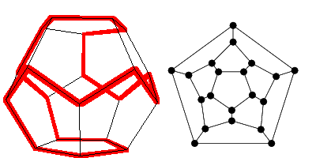
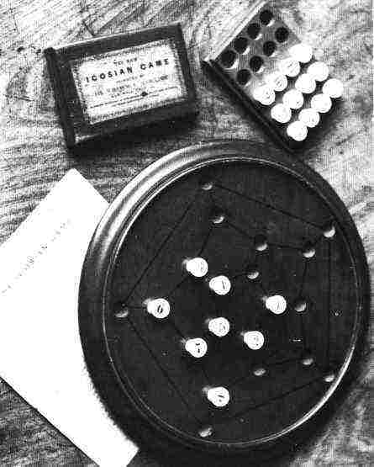
10.5.3 Hamilton Paths and Circuits
Round-the-World Puzzle(周游世界智力题)
Can we traverse all the vertices of a dodecahedron(十二面体), visiting each once?
Equivalent graph
Dodecahedron puzzle
Pegboard version

Slide 75
10.5.3 Hamilton Paths and Circuits
Definition 2
A simple path in a graph G that passes through every vertex exactly once is called a Hamilton path (哈密顿通路), and a simple circuit in a graph G that passes through every vertex exactly once is called a Hamilton circuit (哈密顿回路). That is, the simple path x₀, x₁, … , x_{n−1}, xn in the graph G = (V, E) is a Hamilton path if V = {x₀, x₁, … , x_{n−1}, x_{n}} and x_{i} ≠ x_{j} for 0 ≤ i < j ≤ n, and the simple circuit x0, x_{1,} … , x_{n−1}, x_{n}, x₀ (with n > 0) is a Hamilton circuit if x₀, x₁, … , x_{n−}1, x_{n} is a Hamilton path

Slide 76
10.5.3 Hamilton Paths and Circuits
Hamiltonian Graph（哈密顿图）
A graph has a Hamiltonian tour if there is a tour that visits every vertex exactly once (and returns to its starting point).
A graph with a Hamiltonian tour is called a Hamiltonian graph.
A Hamiltonian path is a path that contains each vertex exactly once.

Slide 77
10.5.3 Hamilton Paths and Circuits
汉密顿通路（回路）
经过图中每个结点一次且仅一次的通路(回路)。
汉密顿图
在汉密顿回路的图

Slide 78
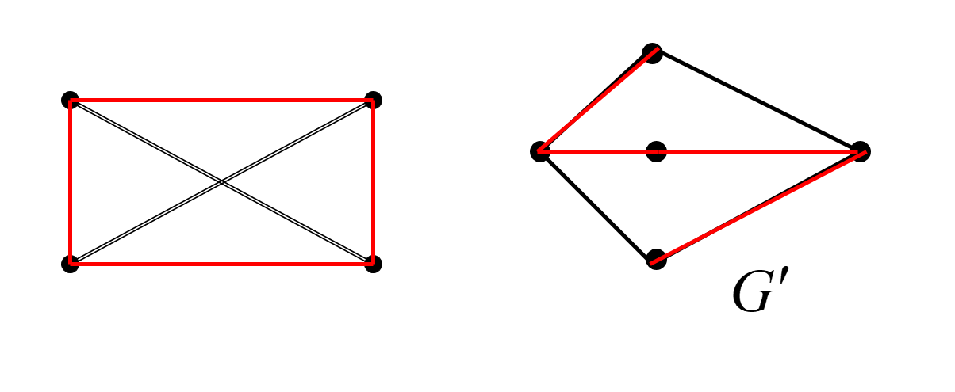
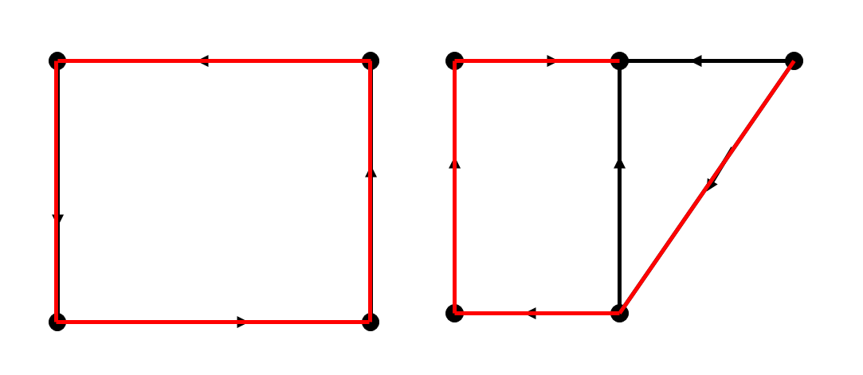

Slide 79
10.5.3 Hamilton Paths and Circuits
Is it Hamiltonian?
A graph of the vertices of a dodecahedron.
Yes.

Slide 80
10.5.3 Hamilton Paths and Circuits
Euler tour Hamiltonian tour
Left one has a Hamiltonian path, but not a Hamiltonian tour.
Right one has an Euler tour, but no Hamiltonian tour.

Slide 81
10.5.3 Hamilton Paths and Circuits
图Ａ 每个顶点都是奇次的，不存在欧拉道路，但有Ｈ道路。 图Ｂ存在欧拉道路，不存在Ｈ道路。

Slide 82
10.5.3 Hamilton Paths and Circuits
Question?
Given a graph, what is a fast way to determine if it is Hamiltonian? Can we give a characterization of Hamiltonian graphs that is as simple as the one for Eulerian graphs?

Slide 83
10.5.3 Hamilton Paths and Circuits
No one knows
There is probably no nice characterization of Hamiltonian graphs the way there was with Eulerian graphs.
Deciding if a graph is Hamiltonian is NP−complete.

Slide 84
10.5.3 Hamilton Paths and Circuits
Partial result
We now state some partial answers that say if a graph G has "enough" edges, a Hamiltonian circuit can be found.
These are again existence statements; no method for constructing a Hamiltonian circuit is given.

Slide 85
10.5.3 Hamilton Paths and Circuits
Hamiltonian Path Theorems
Dirac’s theorem(迪拉克定理): If (but not only if) G is connected, simple, has n≥3 vertices, and ∀v deg(v)≥n/2, then G has a Hamilton circuit.
ORE’s theorem(欧尔定理): If G is connected, simple, has n≥3 nodes, and deg(u)+deg(v)≥n for every pair u,v of non-adjacent nodes, then G has a Hamilton circuit.

Slide 86
10.5.3 Hamilton Paths and Circuits
HAM-CIRCUIT is NP-complete
Let HAM-CIRCUIT be the problem:
Given a simple graph G, does G contain a Hamiltonian circuit?
This problem has been proven to be NP-complete!
This means, if an algorithm for solving it in polynomial time were found, it could be used to solve all NP problems in polynomial time.

Slide 87
10.5.3 Hamilton Paths and Circuits
[定理3]：设Ｇ＝（Ｖ，Ｅ）是ｎ个顶点的简单图，如果任何一对顶点的次之和≥ｎ－１，则Ｇ中一定有Ｈ道路。
证明：
1、Ｇ一定连通，否则Ｇ分为二个不连通的分图Ｇ₁，Ｇ₂，其中Ｇ₁有ｎ₁个顶点，Ｇ₂有ｎ₂个顶点，Ｇ₁中每个顶点次≤ｎ₁－１，Ｇ₂中每个顶点次≤ｎ₂－１，从Ｇ₁中取一个顶点，Ｇ₂中取一个顶点，这一对顶点之和≤ｎ₁－１＋ｎ₂－１＝ｎ₁＋ｎ₂－２＝ｎ－２＜ｎ－１，与定理的假设矛盾。

Slide 88
10.5.3 Hamilton Paths and Circuits
2、用逐步递推构造法证明Ｇ中存在Ｈ道路：
(1)任取一条边（Ｖ₁，Ｖ₂），是含２个顶
点的基本道路。
(2)如果已有ｐ个顶点的基本道路
（Ｖ₁，Ｖ₂，…，Ｖ_{p}），（ｐ≤ｎ－１）
必能构造ｐ＋１个顶点的基本道路。
ａ）如果在Ｖ－｛Ｖ₁，Ｖ₂，…Ｖ_{p}｝中存在与Ｖ₁或Ｖ_{p}相邻的顶点，则基本道路自然可以扩充一个顶点。
ｂ）如果Ｖ₁，Ｖ_{p}仅与｛Ｖ₁，Ｖ₂，…，Ｖ_{p}｝中顶点相邻，则｛Ｖ₁，Ｖ₂，…，Ｖ_{p}｝必可适当排列，形成回路。

Slide 89
10.5.3 Hamilton Paths and Circuits
如果Ｖ₁与Ｖ_{p}相邻，显然成了环。不然，由于Ｖ₁，Ｖ_{p}仅与｛Ｖ₁，Ｖ₂，…，Ｖ_{p}｝中顶点相邻，Ｖ₁，Ｖ_{p}的次≤ｐ－１。不妨设Ｖ₁的次为ｋ≤ｐ－１，分别记相邻顶点为Ｖ_{i1}，Ｖ_{i2}，…，Ｖ_{ik}，它们前面的顶点（指在基本道路｛Ｖ₁，Ｖ₂，…，Ｖ_{p}｝中的序）为 ，Ｖ_{p}必与
中某顶点相邻，否则Ｖ_{p}的次≤ｐ－１－ｋ，Ｖ₁与Ｖ_{p}的次之和≤ｋ＋ｐ－１－ｋ＝ｐ－１＜ｎ－１，与任一对顶点次之和≥ｎ－１矛盾。
不妨Ｖ_{p}与Ｖ_{j-1}相邻，Ｖ₁与Ｖ_{j}相邻。将Ｖ₁与Ｖ_{j}连起来，Ｖ_{p}与Ｖ_{j-1}连起来，并将Ｖ_{j-1}到Ｖ_{j}的边去掉，就形成一个环，如下图所示。

Slide 90
10.5.3 Hamilton Paths and Circuits
又由Ｇ的连通性，总可在Ｖ－｛Ｖ₁，Ｖ₂，…，Ｖ_{p}｝中找到一个点Ｖ_{x}，与｛Ｖ₁，Ｖ₂，…，Ｖ_{p}｝中某一顶相邻，不妨与Ｖ_{k}相邻，Ｖ_{k}≠Ｖ₁，Ｖ_{k}≠Ｖ_{p}，连上Ｖ_{x}与Ｖ_{k}的边，去掉Ｖ_{k-1}到Ｖ_{k}的边，可以从Ｖ_{k-1}为起点，一直走到Ｖ_{k}，再到Ｖ_{x}，这是一条ｐ＋１个顶点的基本道路。

Slide 91
10.5.3 Hamilton Paths and Circuits
如果ｐ＋１＜ｎ，仍继续扩充基本道路内的顶点，直至达到ｎ。
注意:
此定理条件显然不是必要条件，如ｎ≥６的ｎ边形，二个顶点次之和＝４，
４＜ｎ－１，而ｎ边形显然有Ｈ道路。
[定理4]：
Ｇ＝（Ｖ，Ｅ）是ｎ≥３的简单图，若任何一对顶点的次之和≥ｎ，则Ｇ必有哈密顿回路。

Slide 92
10.5.3 Hamilton Paths and Circuits
由于定理4条件也必满足定理3条件，存在Ｈ道路，可类似于定理一的方法找到一条回路。
[定理5]：
有向完全图一定存在Ｈ道路。

Slide 93
10.5.3 Hamilton Paths and Circuits
Theorem 1
Let G be a connected graph with n vertices, n > 2, and no loops or multiple edges. G has a Hamiltonian circuit if for any two vertices u and v of G that are not adjacent, the degree of u plus the degree of v is greater than or equal to n.
G has a Hamiltonian circuit if each vertex has degree greater than or equal to n/2.

Slide 94
10.5.3 Hamilton Paths and Circuits
[定理1]：
设G=(V,E) 为无向简单图。如果G中每对结点度数之和大于等于|V|，则在G中存在一条哈密顿回路。

Slide 95
10.5.3 Hamilton Paths and Circuits
定理1 给出的是哈密顿图的充分条件，而不是必要条件。
两个结点度数之和都是 4 不大于 6。
G是哈密顿图

Slide 96
10.5.3 Hamilton Paths and Circuits
Theorem 2
Let the number of edges of G be m.
Then G has a Hamiltonian circuit if
m≥(n²-3n+6)/2.

Slide 97
10.5.3 Hamilton Paths and Circuits
Proof
Suppose that u and v are any two vertices of G that are not adjacent.
We write deg(u) for the degree of u.
Let H be the graph produced by eliminating u and v from G along with any edges that have u or v as end points.
Then H has n-2 vertices and m-deg(u)-deg(v) edges (one fewer edge would have been removed if u and v had been adjacent).

Slide 98
10.5.3 Hamilton Paths and Circuits
Proof
The maximum number of edges that H could possibly have is _{n-2}C₂.This happens when there is an edge connecting every distinct pair of vertices. Thus the number of edges of H is at most

Slide 99
10.5.3 Hamilton Paths and Circuits
Proof
So
m - deg(u) - deg(v) ≤ (n² - 5n + 6)/2.
Therefore
deg(u)+deg(v) ≥ m - (n² - 5n + 6)/2.
By the hypothesis of the theorem,
deg(u)+deg(v) ≥ (n²-3n+6)/2 - (n²-5n+6)/2 = n.
Thus the result follows from Theorem l.

Slide 100
10.5.3 Hamilton Paths and Circuits
Note
The converses of Theorems l and 2 given above are not true; that is, the conditions given are sufficient, but not necessary, for the conclusion.

Slide 101
10.5.3 Hamilton Paths and Circuits
定理：
设无向图G=<V,E> 是汉密顿图V₁ 是V的任意非空子集，则
P(G-V₁)≤ |V₁|，其中P(G-V₁)是从G中删除V₁（删除V₁ 中各节点及其关联的边）后所得到图的连通分支。

Slide 102
10.5.3 Hamilton Paths and Circuits
利用定理3可以判断某图为非汉密顿图。在G中，若$∃$V₁使得
P(G-V₁)>|V₁|则G不是汉密顿图。
在G’中，取V₁={V₁,V₃}有|P(G-V₁)|=3
|V₁|=2
故G’不是汉密顿图

Slide 103
10.5.3 Hamilton Paths and Circuits

Slide 104
10.5.3 Hamilton Paths and Circuits
定理给出的是汉密顿图的必要条件，而不是充分条件。彼得Peterssen图满足P(G-V₁)≤|V₁|，但它不是汉密顿图
彼得森Peterssen图

Slide 105
10.5.4 Applications of Hamilton Circuits
应用
格雷码

Slide 106
10.5.4 Applications of Hamilton Circuits
计算机鼓轮的设计
a b c d
阴影表示导体 1
空白表示绝缘体0

Slide 107
10.5.4 Applications of Hamilton Circuits
旋转鼓轮其表面被等分成2⁴个部分,问鼓轮上16个部分怎样安排导体和绝缘体,才能使鼓轮每转一部分,四个触点得到一组不同的四位二进制数.

Slide 108
10.5.4 Applications of Hamilton Circuits
按上述方法, 八个结点的有向图共有16条边. 这类图中的任一条路中,其邻接的边必是$α_{1}α_{2}α_{3}α_{4}$和$α_{2}α_{3}α_{4}α_{5}$的形式.
16条边被记成不同的二进制数,可见鼓轮转动所得的16 个不同位置触点上的二进制信息,

Slide 109
0000
对应于图中的一条欧拉回路.
000
1000
0001
100
1001
001
0100
0010
010
0
1
1
1100
1010
0101
0011
1
1
1
1
101
0
0
1101
1011
0
0
110
0110
011
1
0
0
0
1
111
1110
0111
1111

Slide 110
10.5.4 Applications of Hamilton Circuits
The result is
Every Euler tour corresponds to a memory wheel.
000
00
001
100
010
01
10
101
011
110
11
111

Slide 111
10.5.4 Applications of Hamilton Circuits
Theorem
For every n, there exists a memory wheel of size 2^{n} that has all n-bit patterns.
Proof
There are 2 edges in and 2 edges out of every vertex. Graph is connected – can find path from any a to any b.Thus the graph is Eulerian. Every Euler tour corresponds to a memory wheel.

Slide 112
10.5.4 Applications of Hamilton Circuits
Rotating memory drum
Is there a memory wheel with 16 bits in which all 4-bit patterns occur?
Is there a memory wheel with 2^{n} bits in which all n-bit patterns occur?

Slide 113
000
100
001
010
1
0
0
1
0
101
1
1
0
110
011
111
There is an arrow from node a to node b if the last two bits in a equal the first two bits in b.
There is a 1-1 correspondence between Hamiltonian tours of this graph and memory wheels with 8 bits.

Slide 114
10.5.4 Applications of Hamilton Circuits
Hamiltonian graph?
0000
0001
0011
0010
0111
0110
0101
0100
1011
1010
1001
1000
1101
1100
1110
1111

Slide 115
0000
1000
0001
1001
0100
0010
1100
1010
0101
0011
1101
1011
0110
1110
0111
1111

Slide 116
10.6 Shortest Path Problem
A weighed graph is one in which weights (numbers) are assigned to all edges connecting each two vertices.
Such numbers can represent, for instance, traveling distance, monthly cost, or traveling time between two vertices.
The length of a path in a weighed graph is the sum of the weights of the edges of this path. (This use of term length is different from the use of length to denote the number of edges in a path in a graph without weights.)

Slide 117
10.6 Shortest Path Problem
Motivating Example
Find the length of a shortest path between a and z in the weighted graph shown below.

Slide 118
10.6 Shortest Path Problem
Shortest Path (Dijkstra’s )Algorithm
procedure Dijkstra(G: weighted connected simple graph, with all weights positive)
{G has vertices a = v₀, v₁, …, v_{n} = z and weights w(v_{i}, v_{j}) where w(v_{i}, v_{j})=∞ if {v_{i}, v_{j}} is not an edge in G}
for i:=1 to n
L(v_{i}) := ∞
L(a) := 0
S := φ
{the labels are now initialized so that the label of a is 0 and all other labels are ∞, and S is the empty set}
while z ∉ S
begin
u := a vertex not in S with L(u) minimal
S := S ∪{u}
for all vertices v not in S
if L(u) + w(u, v) < L(v) then L(v) := L(u) + w(u, v)
{this adds a vertex to S with minimal label and updates the labels of vertices not in S}
end {L(z) = length of a shortest path from a to z}

Slide 119
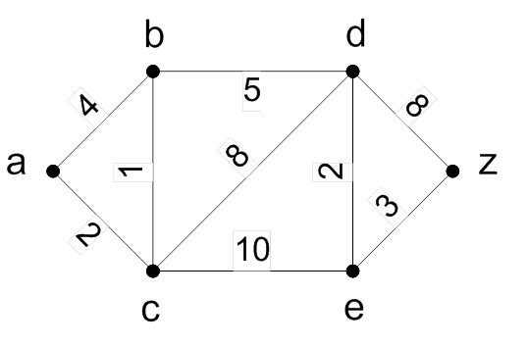
10.6 Shortest Path Problem
Example:

Slide 120
10.6 Shortest Path Problem
Solution:
∞
4 (a)
∞
3 (a, c)
8 (a, c, b)
10 (a, c)
∞
16 (a, c, b, d)
13 (a, c, b, d, e)
∞
∞
10 (a, c, b, d)
2 (a)
12 (a, c)

Slide 121
10.6 Shortest Path Problem
Solution:
∞
4 (a)
∞
3 (a, c)
8 (a, c, b)
10 (a, c)
∞
16 (a, c, b, d)
13 (a, c, b, d, e)
∞
∞
10 (a, c, b, d)
2 (a)
12 (a, c)

Slide 122
10.6 Shortest Path Problem
Dijkstra’s Algorithm Complexity
Theorem 1: Dijkstra’s algorithm finds the length of a shortest path between two vertices in a connected simple undirected weighted graph.
Theorem 2: Dijkstra’s algorithm uses O(n²) operations (additions and comparisons) to find the length of a shortest path between two vertices in a connected simple undirected weighted graph with n vertices.

Slide 123
10.6 Shortest Path Problem
Many problems in the real life are related to the shortest path problem. Such as
Pipe lines
Electric power grid
Communicating network
Railway stations

Slide 124
10.6 Shortest Path Problem
Problem
There are two types of such problems
Determining the shortest path from a vertex to an assigned vertex.
Determining the shortest path of any two vertices in the graph.

Slide 125
10.6 Shortest Path Problem
Dijkstra Algorithm – 迪杰斯特拉算法
The algorithm is to find the shortest way from v₁ to v_{n}, at the same time, it gets the shortest way from v₁ to each other vertices in the graph.

Slide 126
10.6 Shortest Path Problem
A Weighted Simple Graph
b
3
c
2
4
3
z
a
2
1
d
3
e

Slide 127
10.6 Shortest Path Problem
Find a shortest path from a to z
∝
d
∝
b
4
6
1
8
2
z
a
∝
2
3
10
e
c
∝
∝

Slide 128
10.6 Shortest Path Problem
d
4(a)
b
4(a)
∝
4
6
1
8
2
z
a
∝
2
3
10
e
∝
c
2(a)

Slide 129
10.6 Shortest Path Problem
d
4(a)
b
4(a)
∝
4
6
1
8
2
z
a
∝
2
3
10
e
∝
c
2(a)

Slide 130
10.6 Shortest Path Problem
d
10(a,c)
b
3(a,c)
4
6
1
8
2
z
a
∝
2
3
10
e
c
2(a)
12(a,c)

Slide 131
10.6 Shortest Path Problem
d
8(a,c,b)
b
3(a,c)
4
6
1
8
2
z
a
∝
2
3
10
e
c
2(a)
12(a,c)

Slide 132
10.6 Shortest Path Problem
d
8(a,c,b)
b
3(a,c)
4
6
1
8
2
z
a
14(a,c,b,d)
2
3
10
e
c
2(a)
10(a,c,b,d)

Slide 133
10.6 Shortest Path Problem
d
8(a,c,b)
b
3(a,c)
4
6
1
8
2
z
a
2
13(a,c,b,d,e)
3
10
e
c
2(a)
10(a,c,b,d)

Slide 134
10.6 Shortest Path Problem
d
8(a,c,b)
b
3(a,c)
4
6
1
8
2
z
a
2
13(a,c,b,d,e)
3
10
e
c
2(a)
10(a,c,b,d)

Slide 135
10.6 Shortest Path Problem
Example：
Let l_{i} represent the length from v₁ to v_{i}
Let d_{ij} represent the length of the edge (v_{i},v_{j})
Find the shortest path from v₁ to v₁₁
v₂
1
v₅
2
v₈
9
2
5
3
9
7
6
8
1
6
2
v₁₁
v₁
v₃
v₆
v₉
1
7
4
1
2
3
4
v₄
9
v₇
1
v₁₀

Slide 136
10.6 Shortest Path Problem
Step 1
Find the set of adjacent vertices of v₁,which are {v₂, v₃, v₄}
Find the length from v₁ to the vertices in the set.
l₂=d₁₂=2 l₃=d₁₃=8 l₄=d₁₄=1
Find the shortest length of l₂,l₃ ,l₄
Min{l₂,l₃ ,l₄}= l₄=1
Connect v₁ to v₄
v₂
1
v₅
2
v₈
9
2
5
3
9
7
6
8
1
6
2
v₁₁
v₁
v₃
v₆
v₉
7
4
1
1
3
2
4
v₄
9
v₇
1
v₁₀

Slide 137
10.6 Shortest Path Problem
Step 2
Find the set of adjacent vertices of {v₁, v₄} which are {v₂, v₃, v₇}
Find the length from v₁ to the vertices in the set.
l₂=2 l₃=8 l₇= l₄ + d₄₇=1+9=10
Find the shortest length of l₂,l₃ ,l₇
Min{l₂,l₃ ,l₇}= l₂=2
Connect v₁ to v₂
v₂
1
v₅
2
v₈
9
2
5
3
9
7
6
8
1
6
2
v₁₁
v₁
v₃
v₆
v₉
7
4
1
1
3
2
4
v₄
9
v₇
1
v₁₀

Slide 138
10.6 Shortest Path Problem
Step 3
Find the set of adjacent vertices of {v₁, v₂, v₄} which are {v₃, v₅, v₇}
Find the length from v₁ to the vertices in the set.
l₃= min{8,l₂+d₂₃,l₄ +d₄₃}={8,8,8}=8
l₅= l₂ + d₂₅=3
l₇= l₄ + d₄₇=10
min{l₃,l₅ ,l₇}= l₅=3
Connect v₂ to v₅
v₂
1
v₅
2
v₈
9
2
5
3
9
7
6
8
1
6
2
v₁₁
v₁
v₃
v₆
v₉
7
4
1
1
3
2
4
v₄
9
v₇
1
v₁₀

Slide 139
10.6 Shortest Path Problem
Step 4
Find the set of adjacent vertices of {v₁, v₂, v₄ , v₅} which are {v₃, v₆, v₇ , v₈, v₉}
Find the length from v₁ to the vertices in the set.
l₃= 8 l₆= l₅ + d₅₆=6 l₇=10
l₈= l₅ + d₅₈=5 l₉= l₅ + d₅₉=12
Min{l₃,l₆,l₇ ,l₈,l₉}= l₈=5
Connect v₅ to v₈
v₂
1
v₅
2
v₈
9
2
5
3
9
7
6
8
1
6
2
v₁₁
v₁
v₃
v₆
v₉
7
4
1
1
3
2
4
v₄
9
v₇
1
v₁₀

Slide 140
10.6 Shortest Path Problem
Step 5
Find the set of adjacent vertices of {v₁, v₂, v₄ , v₅, v₈} which are {v₃ , v₆, v₇, v₉ , v₁₁}
Find the length from v₁ to the vertices in the set.
l₃=8 l₆= l₅ +d₅₆=6 l₇=10
l₉= l₈ + d₈₉=12 l₁₁= l₈ + d_{8,11}= 14
Min{l₃ ,l₆,l₇ ,l₉ ,l₁₁}= l₆=6
Connect v₅ to v₆
v₂
1
v₅
2
v₈
9
2
5
3
9
7
6
8
1
6
2
v₁₁
v₁
v₃
v₆
v₉
1
7
4
1
2
3
4
v₄
9
v₇
1
v₁₀

Slide 141
10.6 Shortest Path Problem
Step 6
Find the set of adjacent vertices of {v₁, v₂, v₄ , v₅, v₆, v₈} which are {v₃ , v₇, v₉ , v₁₁}
Find the length from v₁ to the vertices in the set.
l₃= min{8, l₆ +d₃₆}={8,7}=7
l₇= min{l₄ + d₄₇, l₆ +d₆₇} =min{10,10}=10
l₉= min{l₈ + d₈₉, l₆ +d₆₉ , l₅ +d₅₉} =min{10,10}=10
l₁₁=14
Min{l₃,l₇ ,l₉ ,l₁₁}= l₃=7
Connect v₆ to v₃
v₂
1
v₅
2
v₈
9
2
6
5
3
9
7
v₁
8
1
6
2
v₁₁
v₃
v₆
v₉
1
7
4
1
2
3
4
v₄
9
v₇
1
v₁₀

Slide 142
10.6 Shortest Path Problem
Step 7
Continue to
connect v₃ to v₇
connect v₇ to v₁₀
connect v₁₀ to v₉
connect v₉ to v₁₁
Then the path from v₁ to v₁₁ is the answer.
At the same time ,we also get the shortest path from v₁ to other vertices in the graph.

Slide 143
10.6 Shortest Path Problem
Finding the shortest path between any two vertices
Distance Matrix: Let G is a graph with n vertices. The distance matrix of G is D=(d_{ij})_{n×n}
d_{ij} represent the the weights of the edge (v_{i},v_{j})
If there’s no edge between v_{i} and v_{j} then d_{ij}=∝
Let D²=D*D= (d_{ij}²)_{n×n}
d_{ij}²=min{d_{i1}+d_{1j}, d_{i2}+d_{2j},…, d_{in}+d_{nj},}
d_{ij}² is the shortest length of the path from v_{i} to v_{j} with two edges.
As the same D^{k}=D^{k-1}*D= (d_{ij}^{k})_{n×n}
d_{ij}^{k} is the shortest length of the path from v_{i} to v_{j} with k edges.

Slide 144
10.6 Shortest Path Problem
Dijkstra’s Algorithm
Procedure Dijkstra(G:weighed connected simple graph, with all weights positive)
s

Slide 145
10.6 Shortest Path Problem
Example:
Here is a graph for a city. Find the shortest path from v₁ to the other vertices in the graph.
v₂
4
v₅
3
v₈
2
4
1
2
2
2
2
1
4
v₁₁
v₁
v₃
v₆
v₉
2
1
1
1
1
2
3
v₄
v₇
v₁₀

Slide 146
10.6 Shortest Path Problem
Step 1
Select a rooted tree with the root v₁
Labeled each vertex with the length to v₁
4
8
11
2
4
5
9
0
1
2
4

Slide 147
10.6 Shortest Path Problem
Step 2
Use l_{i} to represent the length from v₁ to v_{i} in the tree.
If the edge (i,j) in the graph not in the tree, use d_{ij} represent the length from v_{i} to v_{j}.
if l_{j} ≤ l_{i} + d_{ij} for all these edges then the tree gives the answer, Otherwise
l_{j} > l_{i} + d_{ij}
delete the edge end in v_{j},
add (v_{i},v_{j}) in the tree
Modify the length of the vertices it influenced .

Slide 148
10.6 Shortest Path Problem
Step 3
Repeated step until find the answer.

Slide 149
10.6 Shortest Path Problem
1
v₂
4
v₅
3
v₈
4
8
11
2
4
1
2
2
2
4
5
9
0
2
2
1
4
v₁₁
v₁
v₃
v₆
v₉
2
1
1
1
2
4
1
1
2
3
3
7
10
v₄
v₇
v₁₀
2
4
5
9
0
2
4

Slide 150
10.6 Shortest Path Problem
2
v₂
4
v₅
3
v₈
3
7
10
2
2
4
5
9
4
1
2
2
0
2
2
1
4
v₁₁
v₁
v₃
v₆
v₉
1
2
4
2
1
1
1
1
2
3
3
7
10
v₄
v₇
v₁₀
2
3
4
8
0
1
2
4

Slide 151
10.6 Shortest Path Problem
3
v₅
v₈
3
7
10
v₂
4
3
2
2
3
4
8
4
1
2
2
0
2
2
1
4
v₁₁
v₁
v₃
v₆
v₉
1
2
4
2
1
1
1
1
2
3
3
5
8
v₄
v₇
v₁₀
2
4
8
0
3
1
2
4

Slide 152
10.6 Shortest Path Problem
v₅
v₈
3
5
8
v₂
4
3
2
2
4
8
4
2
2
0
3
1
2
2
1
4
v₁₁
v₁
v₃
v₆
v₉
1
2
4
2
1
1
1
1
2
3
3
5
6
v₄
v₇
v₁₀
2
4
8
0
3
1
2
4

Slide 153
10.6 Shortest Path Problem
v₅
v₈
3
5
6
v₂
4
3
2
2
4
8
4
2
2
0
3
1
2
2
1
4
v₁₁
v₁
v₃
v₆
v₉
1
2
4
2
1
1
1
5
6
2
3
3
1
v₇
v₁₀
2
4
7
v₄
3
0
1
2
4

Slide 154
10.6 Shortest Path Problem
Define ⊕
Let A= (a_{ij})_{n×n} , B= (b_{ij})_{n×n}
C=A ⊕ B = (c_{ij})_{n×n}
c_{ij}=min(a_{ij}, b_{ij})
P=D ⊕ D² ⊕ D³ ⊕ … ⊕ D^{n}
p_{ij} = (p_{ij})_{n×n}
p_{ij} represent the shortest length from v_{i} to v_{j}

Slide 155
10.6 Shortest Path Problem
Example:
1
3
3
2
2

Slide 156
10.6 Shortest Path Problem
D₄=(∝) _{4×4}
P=D ⊕ D² ⊕ D³ ⊕D⁴

Slide 157
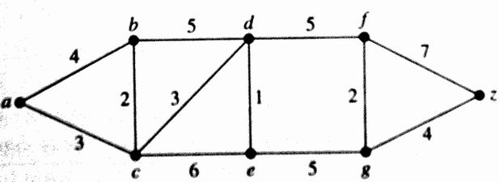
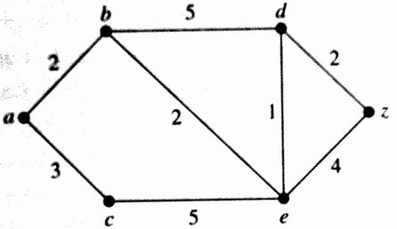
10.6 Shortest Path Problem
Find the shortest path from a to z.
Dijkstra
Matrix

Slide 158
10.6 Shortest Path Problem
Remarks
The problem we have been considering has a number of important variations. In one case, the edges may have weights(权重) representing distance, cost, and the like. The problem is then to find a Hamiltonian circuit (or path) for which the total sum of weights in the path is a minimum. For example, the vertices might represent cities; the edges, lines of transportation; and the weight of an edge. the cost of traveling along that edge. This version of the problem is often called the traveling salesperson problem(旅行商问题).

Slide 159
10.6 Shortest Path Problem
应用问题：旅行商问题（TSP）
Traveling Salesman Problem
问题：从某地出发，恰好一次经过ｎ个城市回到
原地，寻找最短的道路。
实质：无向简单加权图，寻找最短Ｈ回路的问题。
说明：
（1）不一定存在，若无向图是完全图则存在。
（2）图是连通的,两个城市间总有路,若以两城市间交通费用作为边的权,则是无向图的H回路问题.

Slide 160
10.6 Shortest Path Problem
无向加权完全图的最近邻域算法/Approximation：
１．从任一顶点出发，记为Ｖ₁，找一个与Ｖ₁最近的顶点Ｖ₂，（Ｖ₁，Ｖ₂）为两个顶点的基本道路。
２．若找出有ｐ个顶点的基本道路
（Ｖ₁，Ｖ₂，…，Ｖ_{p}），ｐ＜ｎ，在道路外找一个离Ｖ_{p}最近的顶点，记为Ｖ_{p+1}，将其加入则得到具有P+1个顶点的基本道路。
３．若ｐ＋１＝ｎ，转４，否则转２。
４．闭合Ｈ回路：即增加一条边（Ｖ_{n}，Ｖ₁），
则（Ｖ₁，Ｖ₂，…，Ｖ_{n}，Ｖ₁）为一条近似的最短回路。

Slide 161
10.6 Shortest Path Problem
说明：
(1)找最近一个顶点不唯一时，按序取。
(2) 不一定是最短Ｈ回路.
例：
下图是加权无向完全图，从a点出发，用最近邻域法求最短Ｈ回路，并与实际的最短H回路做比较。

Slide 162
10.6 Shortest Path Problem
最近邻域法所求为：（ａ，ｃ，ｅ，ｄ，ｂ，ａ）
总长为７＋６＋８＋５＋１４＝4０
最短回路： （ａ，ｃ，ｅ，ｂ，ｄ，ａ）
总长为７＋６＋９＋５＋１０＝3７。

Slide 163
10.6 Shortest Path Problem
改进:
(1)找一条最短的边e_{i}。
(2)以关联e_{i}的两个顶点v₁,v₂分别作为起点，用最近邻域法求最短H回路。
(3)再比较这两条回路的长度，以确定最短的一条。
如上例:
（ｂ，ｄ）边长为５，最短。
以ｂ为起点：（ｂ，ｄ，ｅ，ｃ，ａ，ｂ）
总长为４０
以ｄ作起点：（ｄ，ｂ，ｅ，ｃ，ａ，ｄ）
总长为３７

Slide 164
10.6 Shortest Path Problem
设Ｇ＝（Ｖ，Ｅ，Ｗ）是ｎ个顶点的完全无向图，满足三角不等式ｗ（ｉ，ｊ）＋ｗ（ｊ，ｋ）≥ｗ（ｉ，ｋ），ｄ₀是最短Ｈ回路Ｄ₀的长度，ｄ是最近邻域法得到的Ｈ回路Ｄ的长度，则:

Slide 165
10.6 Shortest Path Problem
TSP 问题
设有n个城市，城市之间均有道路，一个旅行商从某个城市出发，经过其余n-1个城市一次且仅一次，最后回到出发的城市，他如何才能使他所走的路程最短？
设G=<V,E,W>是n阶完全带权图，各边的权非负。求G中最短的哈密顿回路。
K_{n} n! (n-1)!/2

Slide 166
10.6 Shortest Path Problem
最邻近法
分枝定界法
启发式方法

Slide 167

10.6 Shortest Path Problem

Slide 168
Homework
10.4
14，28，36，60
10.5
8, 10, 16, 26, 34, 48, 58
10.6
8, 16, 18, 26

Slide 169
10.4-10.6
单词表
path（通路）
walk（路径）
circuit（回路）
trail（路线）
connected component（连通分支）
cut vertices（割点）
articulation points（关节点）
cut edge（割边）
bridge（桥）
nonseparable graphs（不可分割图）
vertex cut（点割集）
separating set（分割集）

Slide 170
10.4-10.6
单词表
vertex connectivity（点连通度）
k-connected（k连通的）
biconnected（双联通的）
edge cut（边割集）
edge connectivity（边连通度）
strongly connected components（强连通分支）
strong components （强分支）
giant strongly connected component (GSCC)（巨型强连通分支）
Eulerian graph（欧拉图）
Euler tour（欧拉序）
Euler trail（欧拉迹）

Slide 171
10.4-10.6
单词表
connected multigraph（连通多重图）
Hamilton path（哈密顿通路）
Hamilton circuit（哈密顿回路）

